Slide 1
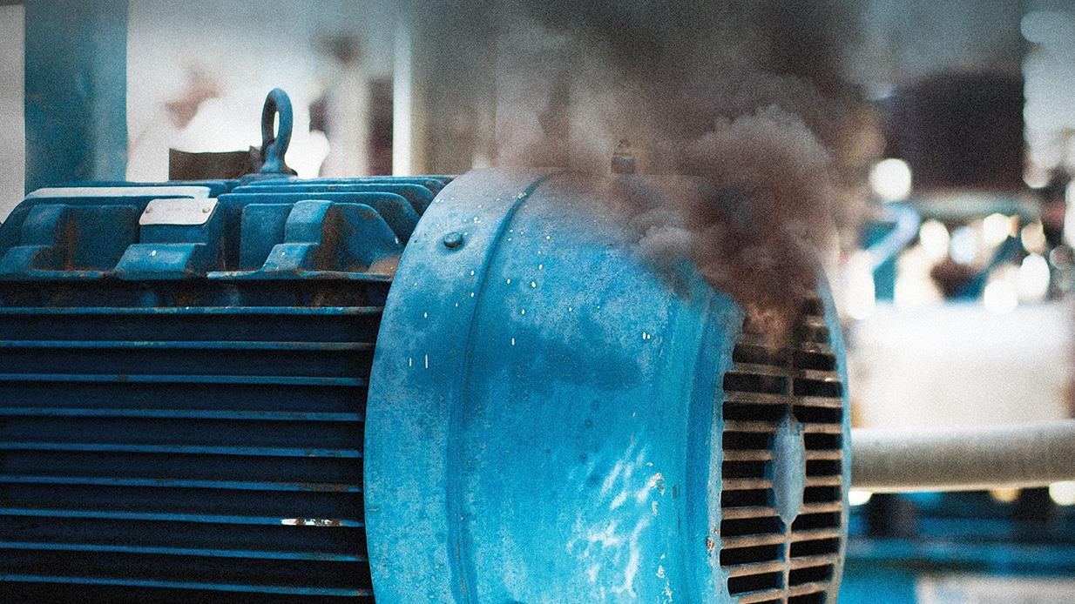
Diagnosis of Machine Component Failure
Problem type: Classification

Slide 2

Problem Statement
An oil refinery plant uses 500 different pumps. When any pump fails it causes production shutdown and incur huge losses
Preventive Maintenance of each machine frequently is extremely expensive.
Diagnosis of failure by looking at signals to detect potential failure of so many machine is a daunting task for few operator
Creating automated solutions for different machine for different failure mode is time consuming, involves so many software and hard to manage
Operators seeking
An automated system that diagnose all the similar machines component failure probability real time
Automatically provide which machine, component and what to fix.

Slide 3
Target: Predict Component Failure
Solution sought
The operation manager needs to decide on,
Probability of failure of component at a certain time
Which component
Which fix and who will fix it
Target
Pump Component Failure
Machine Specification
Operational Condition
Event Record
Maintenance
Pressure
Temperature
Voltage
RPM
Run time
Time of Failure
Error type
What component was maintained
When was last maintained
Age
Model

Slide 4
Pump Operation and Event Record
Operation Data from Scada system
Voltage, RPM, Pressure and Vibrations (16 extra variables)
Last 3Hr Mean
Last 3hr Standard Deviation
Last 24hrs Mean
Last 24hrs Standard Deviation
Failure Event:
Total run time after last failure
Error count based on Error type
Machine Specification
Model
Age

Slide 5

So lets Run with a Robot AI…..

Slide 6
Diagnose the component failure with 4 steps
Login
Name Project “Industrial”and Solution Name “Pump Failure Diagnosis”→ Classification → Click create project
Data
Build Model
Name your data “Pump Data” → upload Component_Fail_Train.csv
Select target. Choose “Failure” as your target
A window will pop up asking you run the preliminary analysis or not. Press Yes Button
Preliminary analysis will run-→see result in Confusion Matrix and Prediction KPI for error
Press Next→ land in “build Model page
Select Variables
Select Unselect Variable
Select Algorithm
Linear Regression
Random Forest
XGBoost
Click on Train
Click on Finalize
You will land on Deploy page

Slide 7
Diagnose the component failure with 4 steps
Deploy
Decision
Click on Add data→
upload new data from CSV source from you computer Comp_Fail_Test.csv file
Create Equation
Go to Result Configuration
Check download as CSV
Select Algorithm
Random forest or other
Press “Predict”, prediction will running
Press Next→ you will land in Decision Page
Select Decision Scenario Tab
Change slider value for different variables
Press Apply
Do the step until Target or Target desired value is higher or lower or middle
Recommendation_XGB =
df['failure_XGB'].map({'none' : 'safe operation', 'comp1' : 'wiring fix', 'comp2' : 'mounting fix', 'comp3' : 'leakage fix', 'comp4' : 'cavitation fix' })
Worker_XGB =
df['failure_XGB'].map({'none' : 'None', 'comp1' : 'Joe Biden', 'comp2' : 'Shakib Khan', 'comp3' : 'Donald Trump', 'comp4' : 'Anonto Jolil' })

Slide 8


